Slide 1
Data Repository
January 2023

Slide 2
Outline
1 Main Concept
2 Structure
3 Datasets
4 Back-end
5 Team Strategy
Appendix

Slide 3
Main Concept

Slide 4
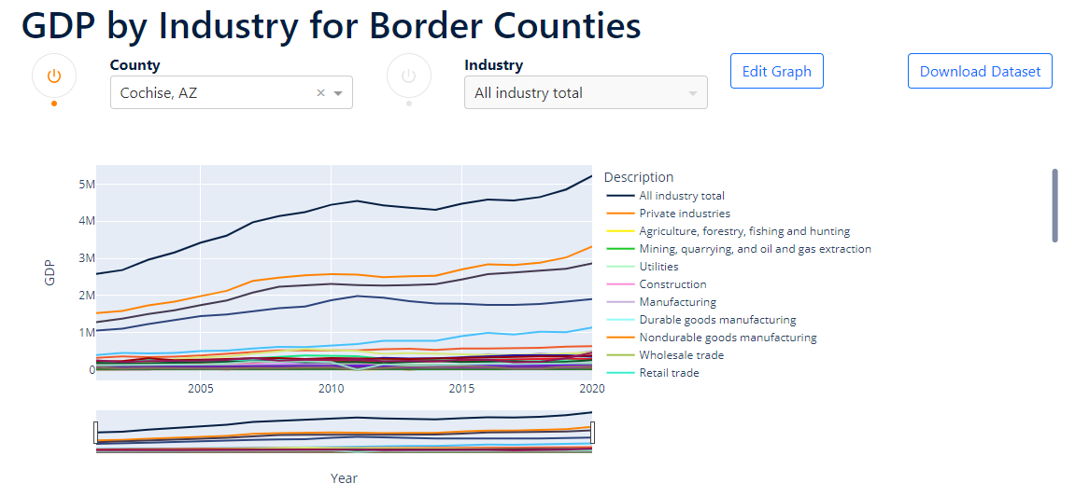
Purpose
The Data Repository is meant to be an interactive tool that will display relevant information in regard to different indicators that may later impact decision-making.
Note:
Source:

Slide 5
Purpose
Information is put into datasets, from which information is converted into dataframes that can be manipulated and turned into interactive formats of visualization.
Overall, we are looking to display numbers (crime rates, poverty rates, imports, etc.).
Note:
Source:

Slide 6
Structure

Slide 7
Sections
There are currently 6 sections:
Demographic Indicators
Economic Indicators
Border Security
Education
Social Indicators
Transportation
Each have their different datasets.
Note:
Source:

Slide 8
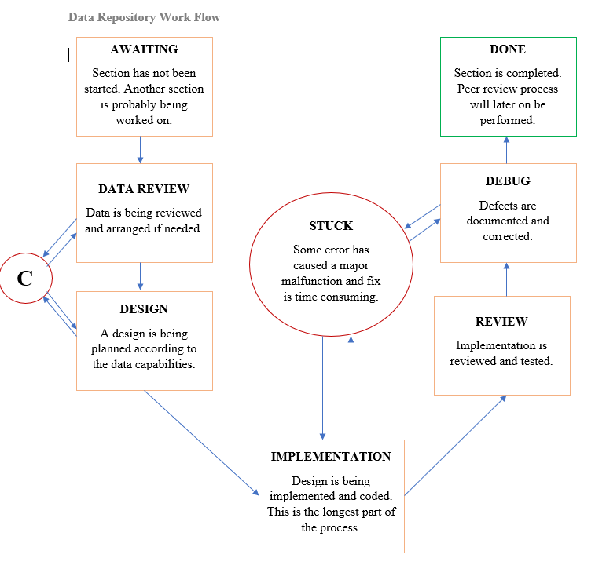
Workflow
Working on a section involves the process on the left. Time estimation is hard because some data is harder to manipulate, which makes designing more time consuming.

Slide 9
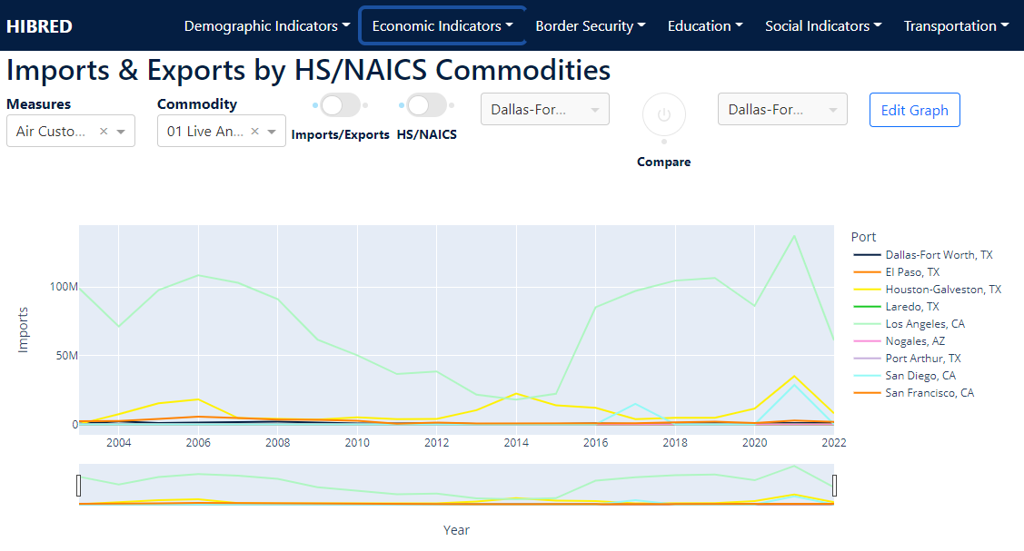
Layout
Note:
Source:

Slide 10
Main Ideas
The main ideas behind the Data Repository are:
Quick access to information (reduce click action).
Each dataset has its own tailored subsection.
Data is not wasted.
Note:
Source:

Slide 11
General Features
Each subsection contains the following:
Different dropdowns or buttons to filter information.
An Edit Graph button.
A Download Dataset button.
An information box
The graph itself.
Note:
Source:

Slide 12
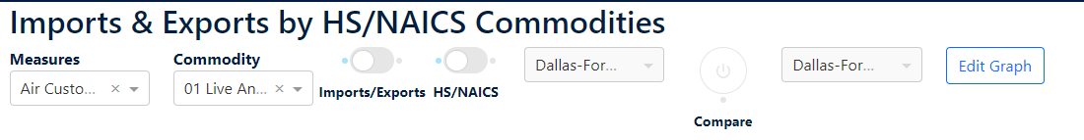
Dropdowns and Buttons
Depending on the nature of the dataset, we might incorporate different elements to filter its information or display different views of the dataset.

Slide 13
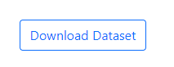
Download Dataset Button
This button will simply provide the user with an excel file that contains all the data.

Slide 14
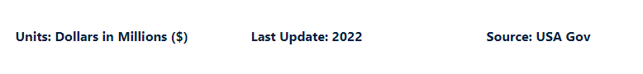
Information Box
This is located at the bottom of every subsection, and includes the units, source, and last update of information.

Slide 15
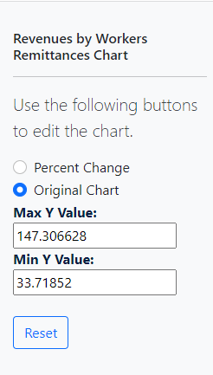
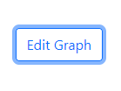
Edit Graph Button
This button reveals a sidebar that allows the user to change the way the information is displayed.
This feature was born from the need to add a percent change view of the information.

Slide 16
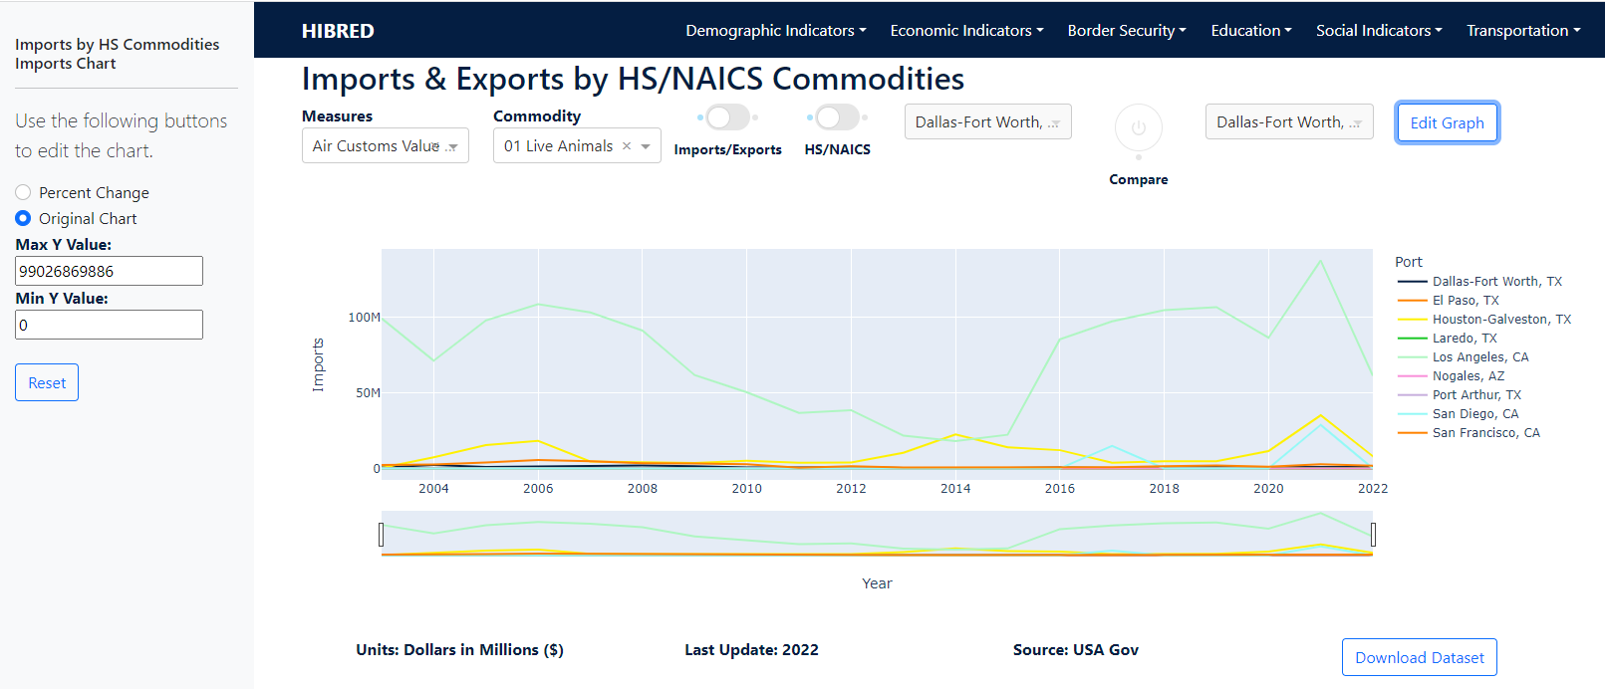
Current View

Slide 17
Datasets

Slide 18
Format
Datasets are provided in an Excel format. Information is organized in columns, which allows us to manipulate it through data frames.
If information is organized in a format that makes the manipulation of information too complex, it is better to normalize it into a format that will be more friendly.
Note:
Source:

Slide 19
Format
It is of great importance that we take the following into consideration:
All columns should have a significative name
Columns with numeric data should contain only numeric values
Columns that contain empty cells could cause conflict when grouping the information.
Note:
Source:

Slide 20
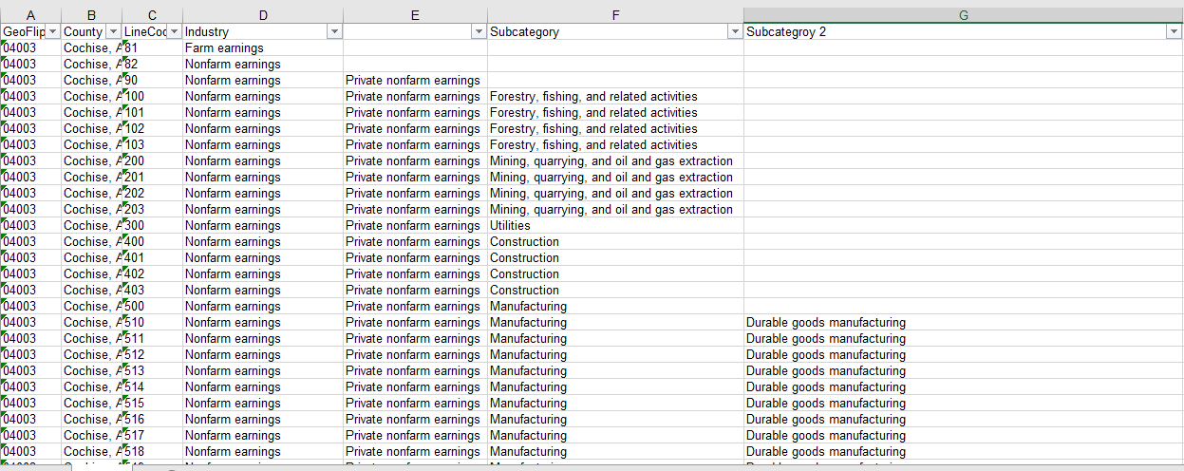
Sample

Slide 21
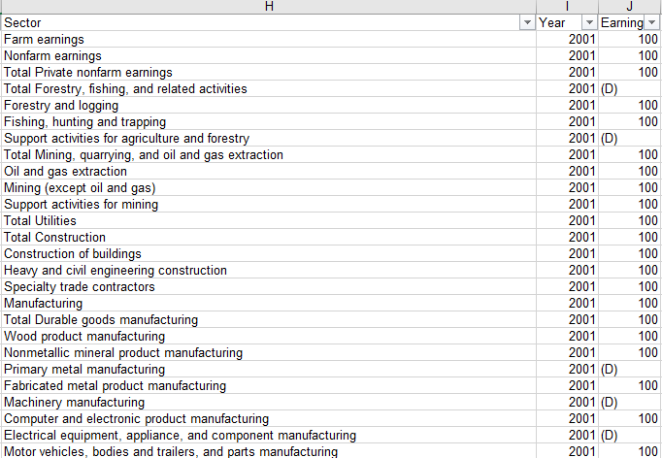
Sample

Slide 22
Back-end

Slide 23
Classes
Dataset Class:
Stores a dataframe and its variant (percent change version). Its purpose is to be able to store the original data along with a percent change version, and simply change between them instead of recreating them time after time.
As the user switches between the Original Graph and the Percent Change graph, this class will simply activate one or the other.
This allows us to add more variants of the dataset in the future if needed.

Slide 24
Classes
DataBag Class
This class stores the different datasets for each subsection. As they are requested, the system looks for the desired dataset in the DataBag and retrieves its information.
This is a way to keep control of the datasets while using the sidebar to modify the graphs.

Slide 25
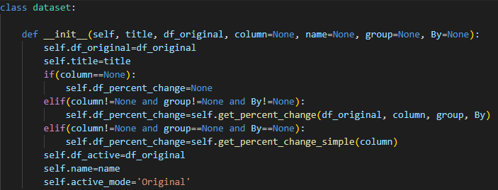
Data Handling
On creation, the dataset class will take a dataframe and create a Percent Change view of the data and store it. The original dataframe will be set as the active view of the dataset.

Slide 26
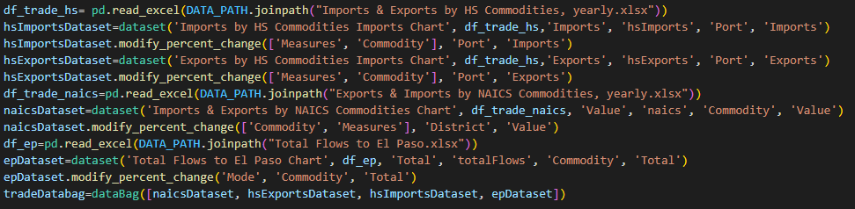
Data Handling
Dataframes are created from Excel files and an object of the dataset class is created.
Later, a DataBag is created with all of the objects of the dataset class.

Slide 27
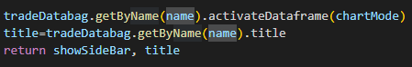
Data Handling
When using the sidebar to alter the chart, we look into the DataBag using the name or title of the chart from which we clicked on the Edit Graph button.
Once we find the dataset, we activate the dataframe view that has been selected.

Slide 28
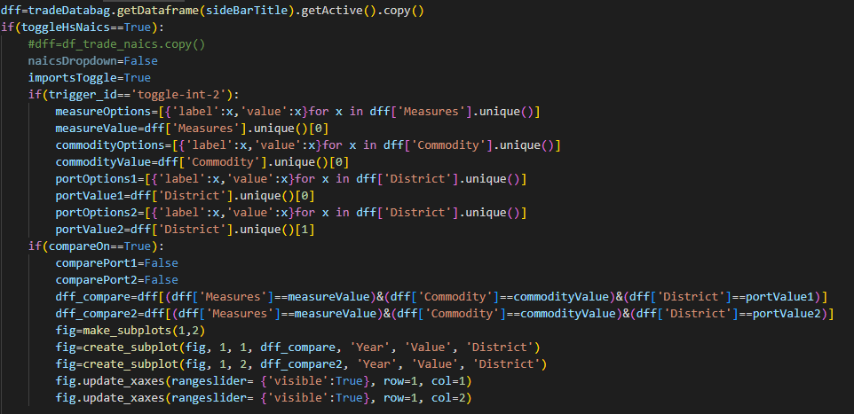
Data Handling

Slide 29
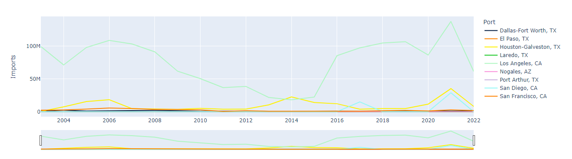
Data Handling

Slide 30
Data Handling
Like everything, this process varies depending on the data that is available for us to manipulate and the way it is arranged.
However, the dataset and DataBag classes have different methods that have been modified overtime and might come handy depending on the situation.

Slide 31
Team Strategy

Slide 32
Upcoming Sidebar Features
Any major upcoming features will mostly be requested on the SideBar, where more elements will be placed to manipulate the graph by the user.
The main functionality of the sidebar has already been implemented, so any requested change will simply involve adding another feature onto that functionality in a way that is efficient and as simple as possible.

Slide 33
Workload Distribution
There are a total of 14 pages that must be completed and updated as requested.
Since every page is tailored to the specific type of data, completion of the project is more time consuming.

Slide 34
Workload Distribution
Eduardo
Demographic Indicators - Population
Economic Indicators - Employment, International Trade Flows, Industry
Border Security - Migration
Education - Educational Attainment Rate
Social Indicators - Crime
Darinka
Economic Indicators - Income, Remittances
Border Security - Border Patrol Agent Staffing, Apprehensions
Social Indicators - Poverty
Transportation - Airport Activity, Border Crossings
We will be using a GitHub repository to upload changes, which is why workload has been divided by sections. As we both will have different sections, changes will not collide and pull and push requests will succeed.

Slide 35
Pending Work
Finish integrating the sidebar on all pages.
Corroborate that all functionalities work appropriately
Integrate any new requests.

Slide 36
Locate us:
The University of Texas at El Paso Hunt Institute for Global Competitiveness University of Texas at El Paso (UTEP) Kelly Hall Building, Suite 414 El Paso, Texas 79968-0545
Monthly Newsletter
Sign up today!
View our Newsletter
Connect with us:
E: huntinstitute@utep.edu P: (915) 747-6727 F: (915) 747-7948

